Slide 1

System Dynamics Model Calibration in Vensim®
A workshop hosted by the CUNY SPH Systems Science Club and the Center for Systems and Community Design
Facilitator: Rachel L. Thompson, MS
April 11, 2024

Slide 2
Agenda
1:00 PM – 1:45 PM Lecture on calibration theory
1:45 PM – 2:05 PM Questions & break
2:05 PM – 2:30 PM Vensim setup, model review, & basic calibrations
2:30 PM – 3:00 PM Weighted calibration using maximum likelihood estimation
3:00 PM – 3:15 PM Break
3:15 PM – 4:00 PM Markov Chain Monte Carlo simulation & sensitivity analysis
4:00 PM Adjourn

Slide 3


Workshop Materials Attribution
Many of the details and examples for this workshop were taken from the Vensim® Video Library, originally authored by Tom Fiddaman (Ventana Systems, Inc.)
https://vensim.com/vensim-video-library/

Slide 4
Calibration Theory

Slide 5
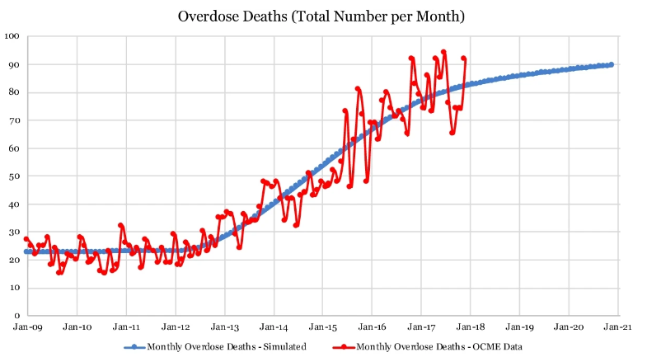
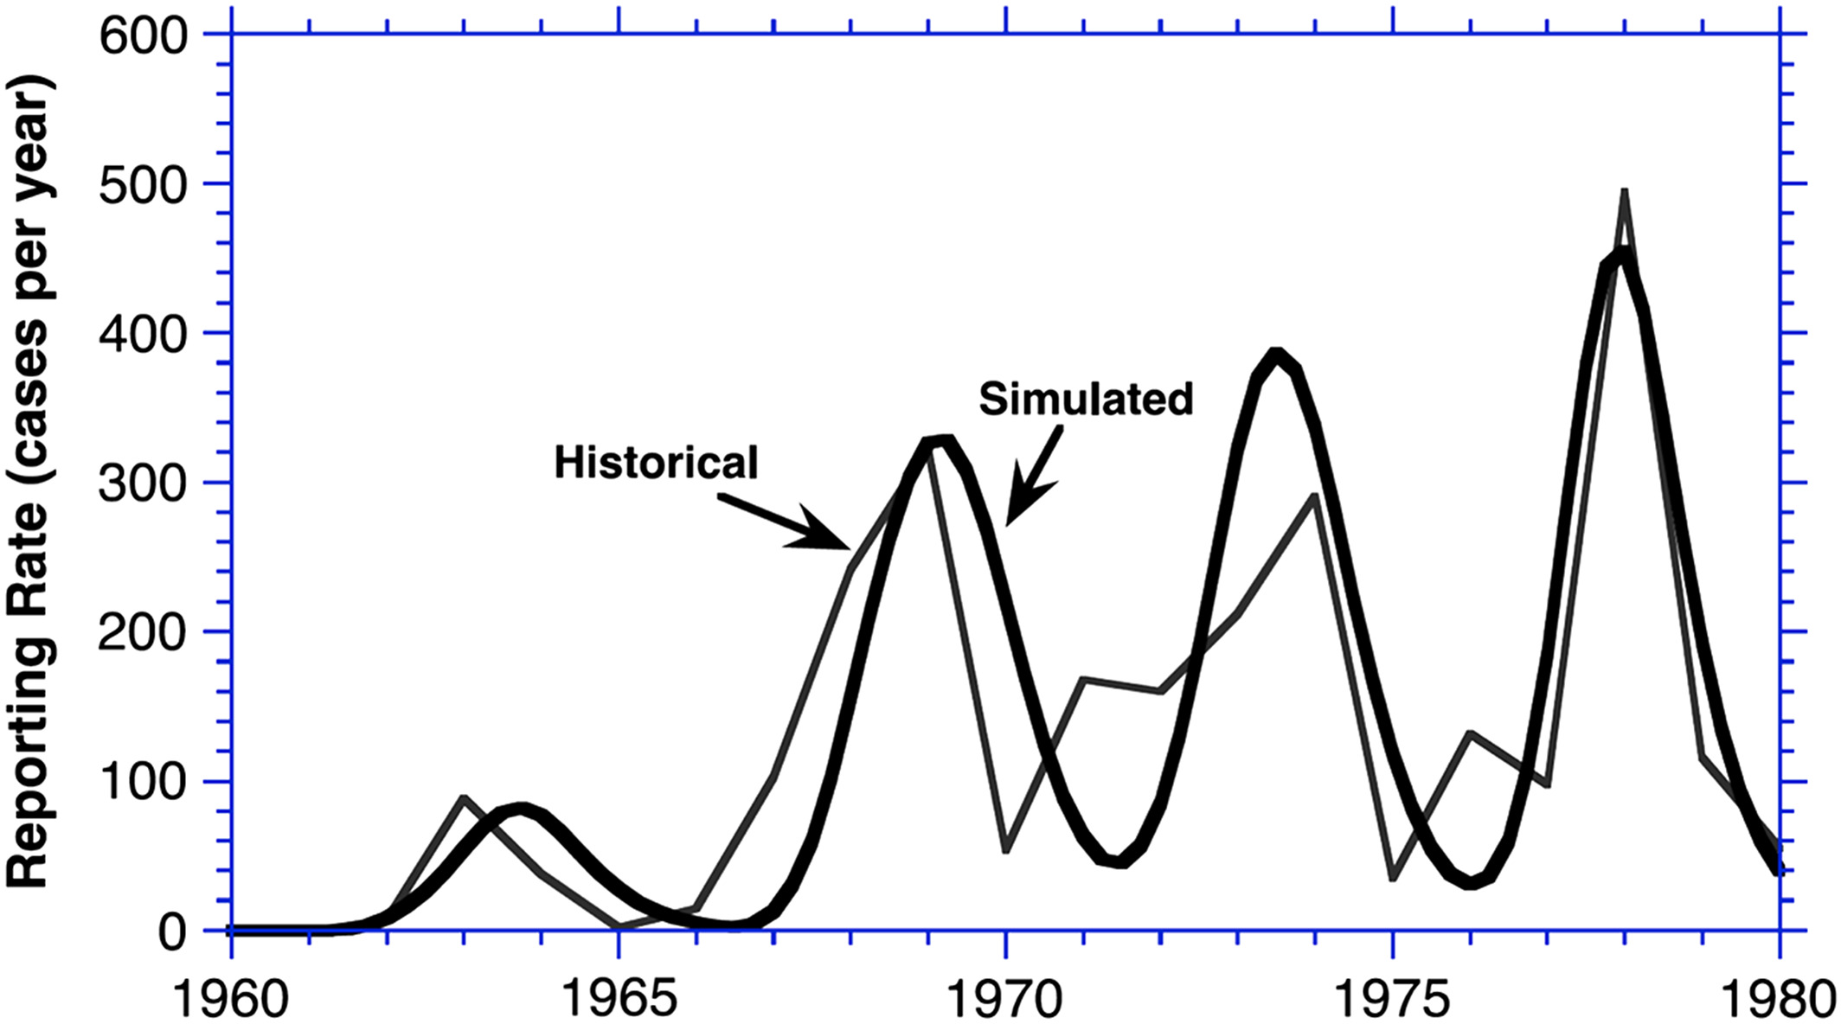
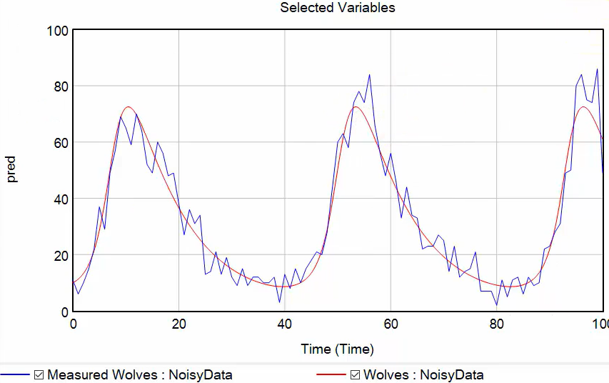
What is model calibration in system dynamics?
“The process of estimating model parameters (structure) to obtain a match between observed and simulated structures and behaviors”
Rogelio Oliva in "Model calibration as a testing strategy for system dynamics models." European Journal of Operational Research 151, no. 3 (2003): 552-568.

Slide 6
Calibration: Purpose
Make better predictions or measurements
Reject models that can’t replicate data
Learn more about the model
Learn more about the data
Provide face validity for reviewers

Slide 7
Calibration: General Process
Assume that model structure is right***
***Test alternatives, if possible!
Simulate the model
Measure closeness between model simulated values and data
Adjust the constant parameters in the model
Iterate to improve fit (minimize difference between model simulated values and data)
This can be done by “hand adjusting” parameters or using an algorithm
After convergence, evaluate fit between data and simulated values
Decide if model needs revision
Investigate potential issues in data

Slide 8
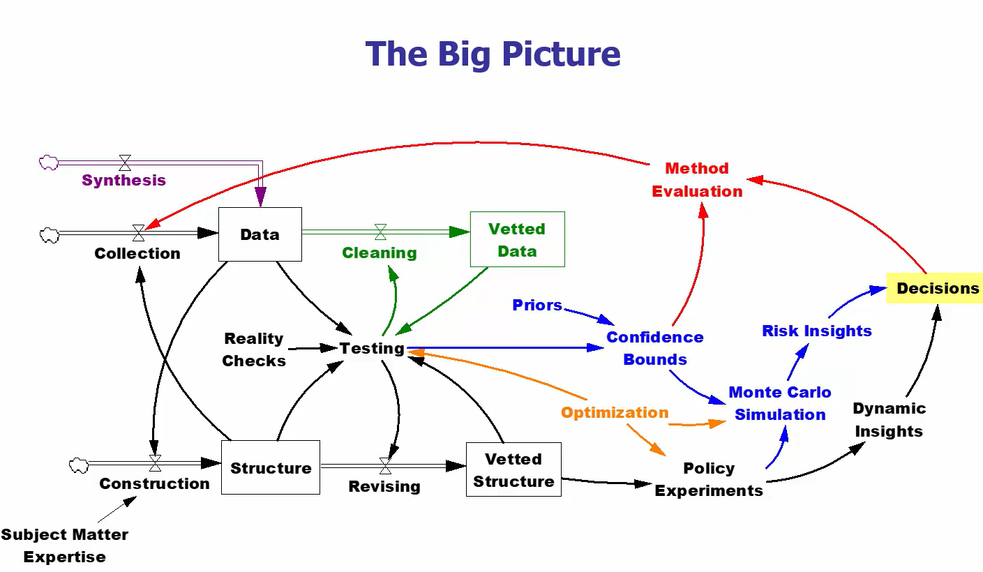

Model calibration is one small part of a larger iterative process of model testing and validation

Slide 9
What model calibration IS :
What model calibration IS NOT:
A model validation exercise
A model that fits data well can build trust that you have a reasonable structure
A data vetting exercise
The act of calibration can reveal problems with the data alongside problems with the model
A weak test of model quality
Must be done in conjunction with other model validation exercises (e.g., checking units, verifying dimensional consistency, checking structure with subject matter experts)
The only model validation exercise
A model that fits data well is not necessarily a valid model!!
A source of absolute truth
The data used in calibration carry multiple sources of uncertainty
Errors in data collection
Errors in data reporting
Bias in selection, use, and interpretation of data
Errors in model formulation
Random error

Slide 10
Naïve Calibration
General Process
Create a simple metric (called a payoff or an objective function) measuring the distance between the model simulated values and the data points
Repeatedly vary the values of the parameters by small amounts, measuring the payoff each time
Continue until the difference between the model simulated values and the data points is the smallest you can get (minimize the differences between data and simulation, maximizing the payoff)

Slide 11
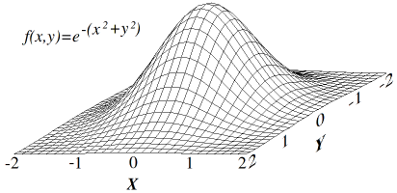
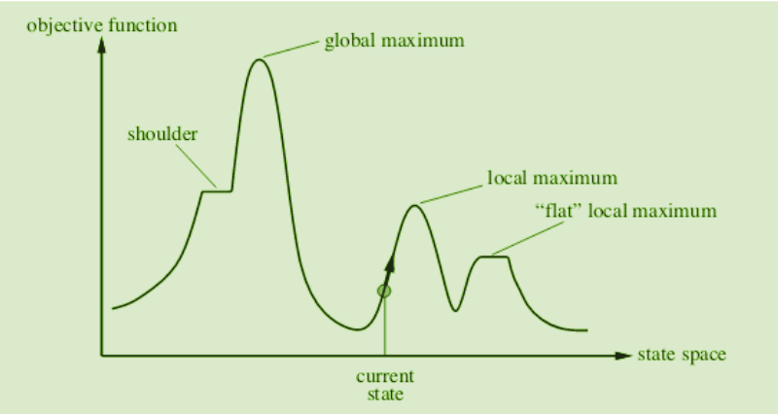
Naïve Calibration
A payoff surface with only one maximum:
What happens when we optimize?
“Hill Climbing” optimizer
Parameters are varied one-by-one and in combinations by small amounts until the best combination of parameter values is found
Algorithm is encouraged to move towards a better and better payoff
This process may need to repeat thousands of times in order to find the maximum payoff (“top of the hill”)
Algorithm stops when it thinks it has reached the maximum payoff
Multiple restarts may be needed in order to find the global maximum (instead of settling in local maxima) since algorithm is blind to complete payoff space
https://en.wikipedia.org/wiki/Hill_climbing#/media/File:Hill_climb.png
A payoff surface with multiple maxima:
https://www.geeksforgeeks.org/introduction-hill-climbing-artificial-intelligence/

Slide 12
Naïve Calibration
Pitfalls
Naïve calibration does not properly recognize variations in data scale and data quality
Each data series used to calibrate the model is considered to have equal contribution to the payoff
Equal quality (equal error)
Equal scale
In reality, data used for model calibration varies in scale and quality
Over time (bigger data = bigger error, so more absolute error when a disease is highly prevalent vs. extremely rare)
Across different measurements (e.g., # of people with a disease vs. # of medications in supply vs. avg. dose of medication)
Failing to properly weight the contributions of the data to the payoff means that you won’t be able to accurately characterize uncertainty within the model (e.g., compute confidence bounds)

Slide 13
Maximum Likelihood Estimation (MLE)
Goal: choose the values of parameters that maximize the likelihood of observing the data, given the model
Likelihood expresses the probability of getting the data observed from your model, NOT the chance that the model is right
Computation of likelihood (and log likelihood) values incorporates weights for each data series (which can be estimated by calibration, if unknown)

Slide 14
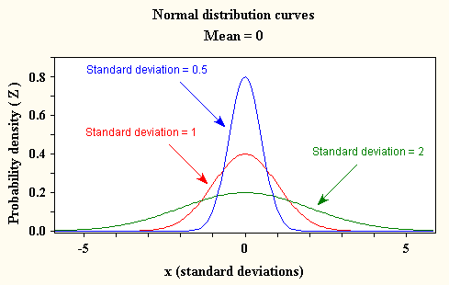
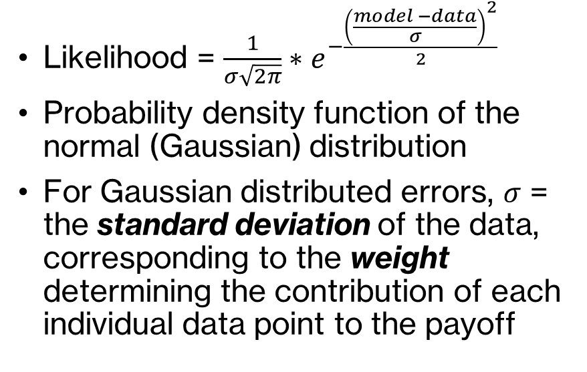
Calculating Log-Likelihood Payoff with Gaussian Errors
Likelihood = $\frac{1}{σ\sqrt{2π}}∗e^{−\frac{{\left(\frac{model −data}{σ}\right)}^{2}}{2}}$
Probability density function of the normal (Gaussian) distribution
For Gaussian distributed errors, $σ$ = the standard deviation of the data, corresponding to the weight determining the contribution of each individual data point to the payoff
https://influentialpoints.com/Training/normal_distribution-principles-properties-assumptions.htm

Slide 15
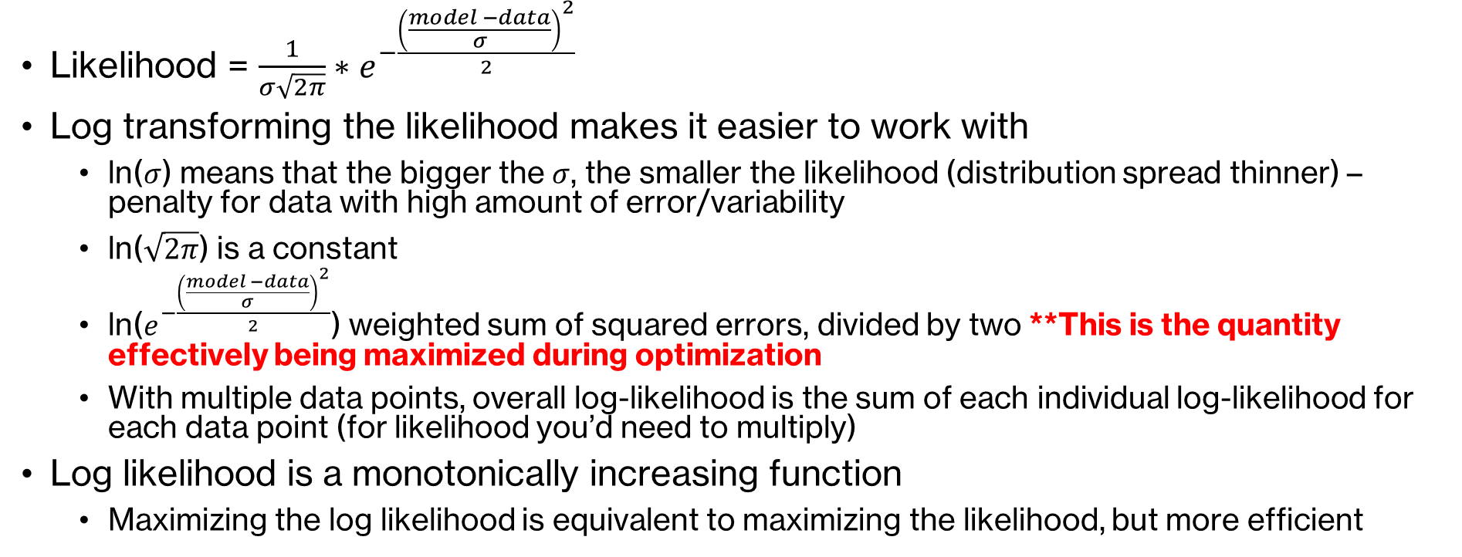
Calculating Log-Likelihood Payoff with Gaussian Errors
Likelihood = $\frac{1}{σ\sqrt{2π}}∗e^{−\frac{{\left(\frac{model −data}{σ}\right)}^{2}}{2}}$
Log transforming the likelihood makes it easier to work with
ln($σ$) means that the bigger the $σ$, the smaller the likelihood (distribution spread thinner) – penalty for data with high amount of error/variability
ln($\sqrt{2π}$) is a constant
ln($e^{−\frac{{\left(\frac{model −data}{σ}\right)}^{2}}{2}}$) weighted sum of squared errors, divided by two **This is the quantity effectively being maximized during optimization
With multiple data points, overall log-likelihood is the sum of each individual log-likelihood for each data point (for likelihood you’d need to multiply)
Log likelihood is a monotonically increasing function
Maximizing the log likelihood is equivalent to maximizing the likelihood, but more efficient

Slide 16
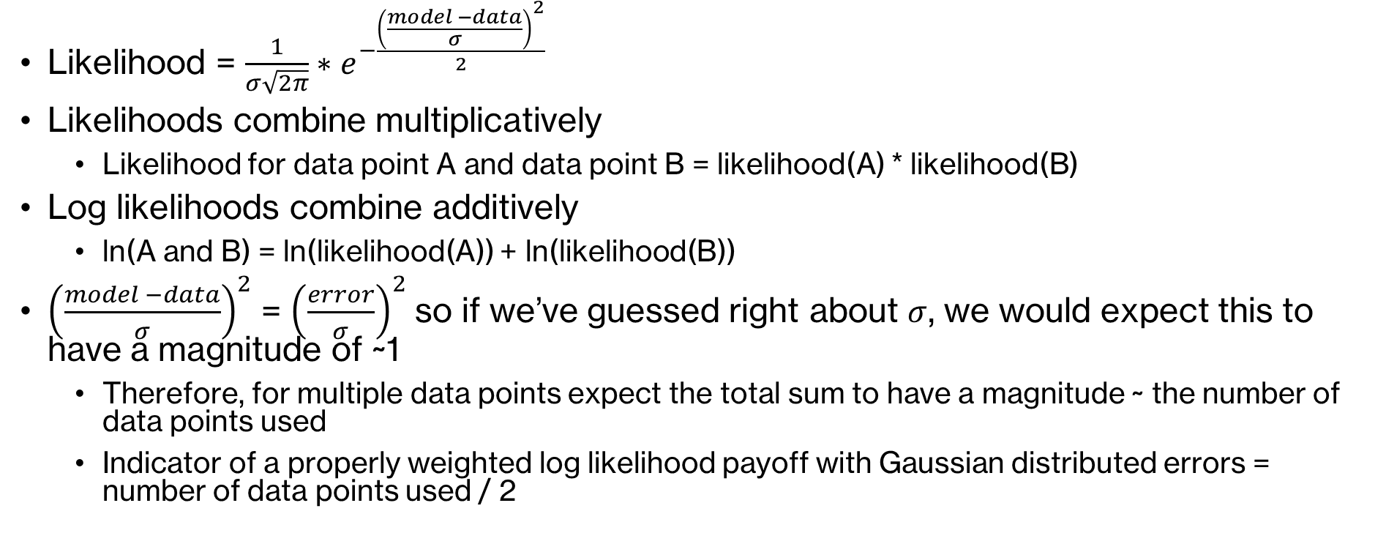
Calculating Log-Likelihood Payoff with Gaussian Errors
Likelihood = $\frac{1}{σ\sqrt{2π}}∗e^{−\frac{{\left(\frac{model −data}{σ}\right)}^{2}}{2}}$
Likelihoods combine multiplicatively
Likelihood for data point A and data point B = likelihood(A) * likelihood(B)
Log likelihoods combine additively
ln(A and B) = ln(likelihood(A)) + ln(likelihood(B))
${\left(\frac{model −data}{σ}\right)}^{2}$ = ${\left(\frac{error}{σ}\right)}^{2}$ so if we’ve guessed right about $σ$, we would expect this to have a magnitude of ~1
Therefore, for multiple data points expect the total sum to have a magnitude ~ the number of data points used
Indicator of a properly weighted log likelihood payoff with Gaussian distributed errors = number of data points used / 2

Slide 17
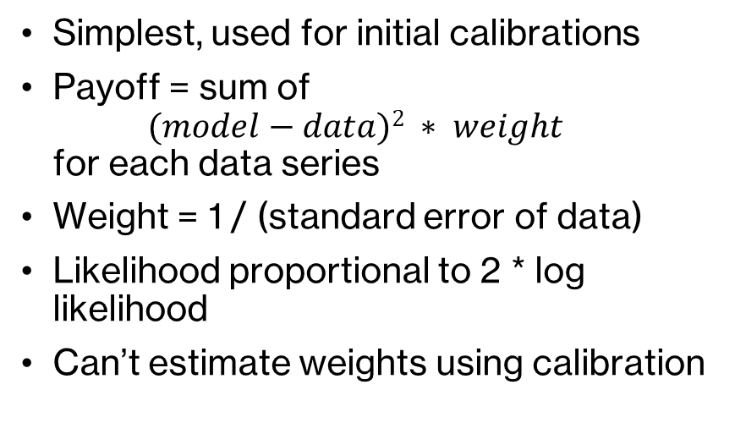
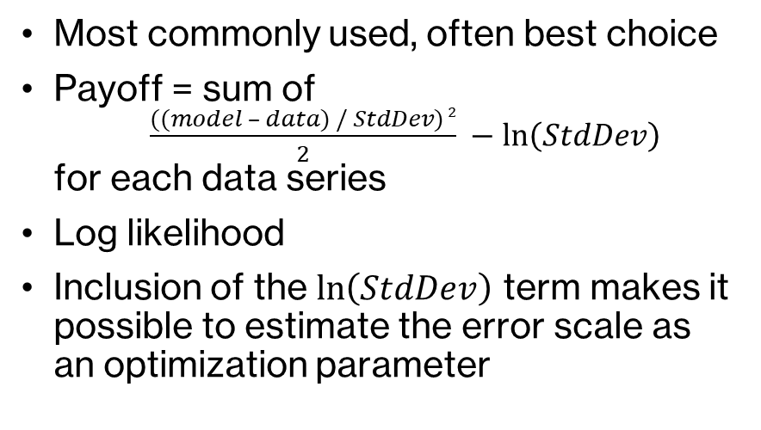
MLE Possible Error Distributions in Vensim ®
Normal
Gaussian***
Simplest, used for initial calibrations
Payoff = sum of $(model−data)2 ∗ weight$ for each data series
Weight = 1 / (standard error of data)
Likelihood proportional to 2 * log likelihood
Can’t estimate weights using calibration
Most commonly used, often best choice
Payoff = sum of $\frac{((model – data) / StdDev) 2}{2} −\ln\left(StdDev\right)$ for each data series
Log likelihood
Inclusion of the $\ln\left(StdDev\right)$ term makes it possible to estimate the error scale as an optimization parameter
***Most of the examples today will be assuming Gaussian distribution of errors and a log-likelihood payoff value

Slide 18
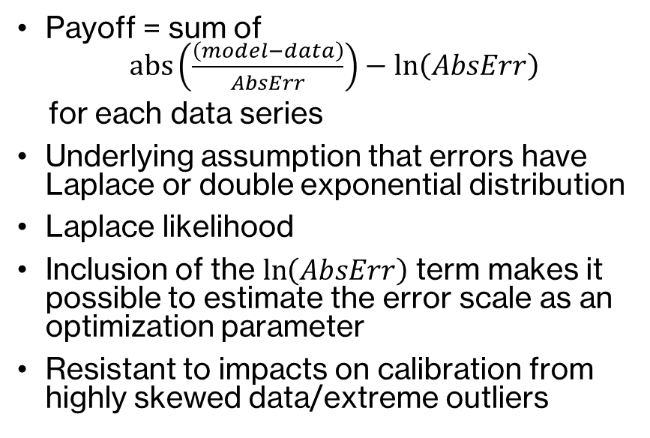
MLE Possible Error Distributions in Vensim ®
Robust
Others
Payoff = sum of $abs\left(\frac{\left(model−data\right)}{AbsErr}\right)−\ln\left(AbsErr\right)$
for each data series
Underlying assumption that errors have Laplace or double exponential distribution
Laplace likelihood
Inclusion of the $\ln\left(AbsErr\right)$ term makes it possible to estimate the error scale as an optimization parameter
Resistant to impacts on calibration from highly skewed data/extreme outliers
Kalman
Huber
Binomial
Poisson
https://www.vensim.com/documentation/extended_payoffs.html
How do I know which error distribution to use? -> Verify post-calibration by checking distributions of model residuals (differences between simulated values and data)

Slide 19
Methods for Determining Weights/Errors of Data Series
Educated guess or prior knowledge
“plus or minus x%”
Iterate
Run the model
Look at payoff or residuals
Manually adjust error to improve fit
Estimate as part of calibration
Include the error or weight as an optimization control parameter
Add extra weight terms to the payoff

Slide 20
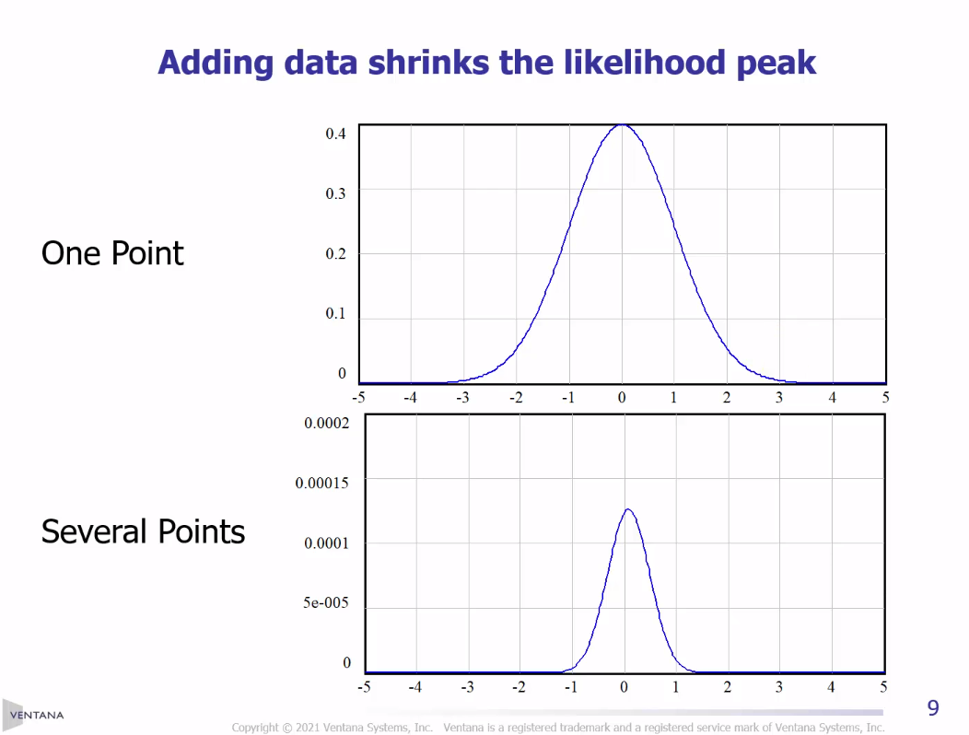
In MLE, More Data is Better… Better Data is Also Better
Combining noisy measurements from multiple sources shrinks the likelihood peak
Better data also shrinks the likelihood peak
Narrower likelihood peak = better idea of what “true” value may be

Slide 21
Summary: Model Calibration Steps
Build an SD model
Identify relevant time series data
Define a payoff by identifying the relevant:
Data series and matching model variables
Error distribution (e.g., Gaussian, Robust, Normal)
Likelihood function (e.g., Likelihood or Log Likelihood)
Error/weight values (could be estimated or guesstimated)
Iteratively vary parameter values one-by-one and together to obtain the set of values which maximizes the payoff (i.e., likelihood of observing the data, given the model)
Evaluate model fit to data
Make any changes to model structure, investigate issues with data, and examine model residuals
Repeat starting with step 3, making any necessary changes to the payoff definition

Slide 22
Questions & Break

Slide 23
Vensim Setup & Model Review

Slide 24
Vensim® Setup
Everyone should be running Vensim® DSS
Let me know if you don’t have a copy and I can help you install a temporary workshop version
Download workshop materials from my Github page: https://github.com/ralythompson24/sd-model-calibration-in-vensim-workshop

Slide 25
Model Review
Open SEIR Model.mdl in Vensim®
Explore the model structures and equations
Run the model – what do you observe?

Slide 26
Basic (Naïve) Calibrations

Slide 27
Calibration in Vensim ®
What do we need?
Data (.vdf file or equations with GET DIRECT DATA, GET XLS DATA)
Payoff Definition (.vpd file)
Specify which data series to match to which variables in the model, how to weight each data series (by specifying the error distribution)
Optimization Control File (.voc file)
Specify which parameters to vary and ranges
Specify which optimization methods to use

Slide 28
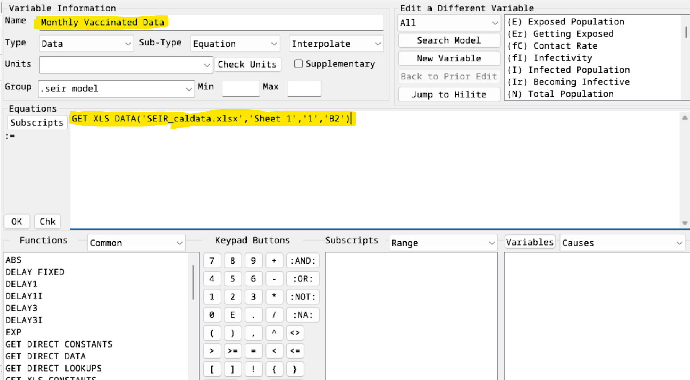
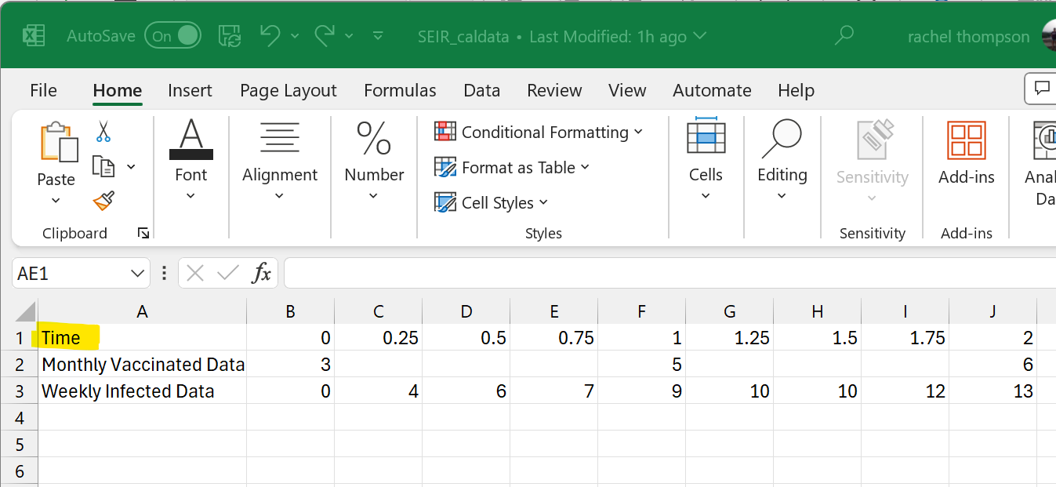
Calibration in Vensim ®
What do we need?
Data (.vdf file or equations with GET DIRECT DATA, GET XLS DATA)
This model has come pre-loaded with data using a GET XLS DATA function

Slide 29
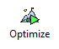
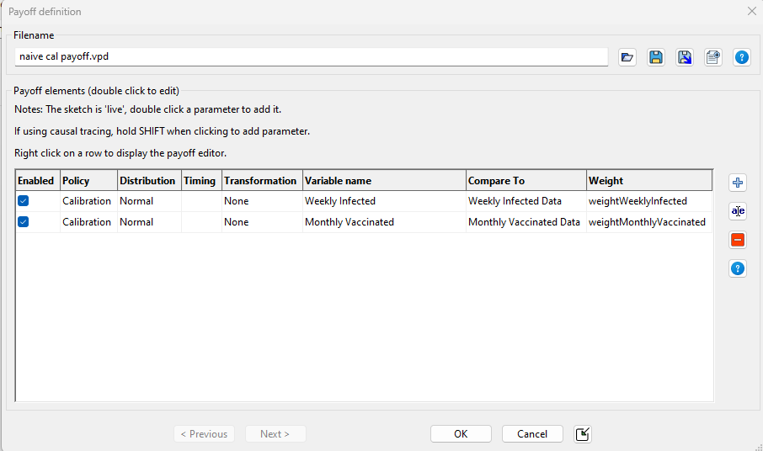
Calibration in Vensim ®
What do we need?
Payoff Definition (.vpd file)
Specify which data series to match to which variables in the model, how to weight each data series (by specifying the error distribution)
In “Simulation Control” under “Optimize”
set up file `naive cal payoff.vpd` with the following settings:

Slide 30
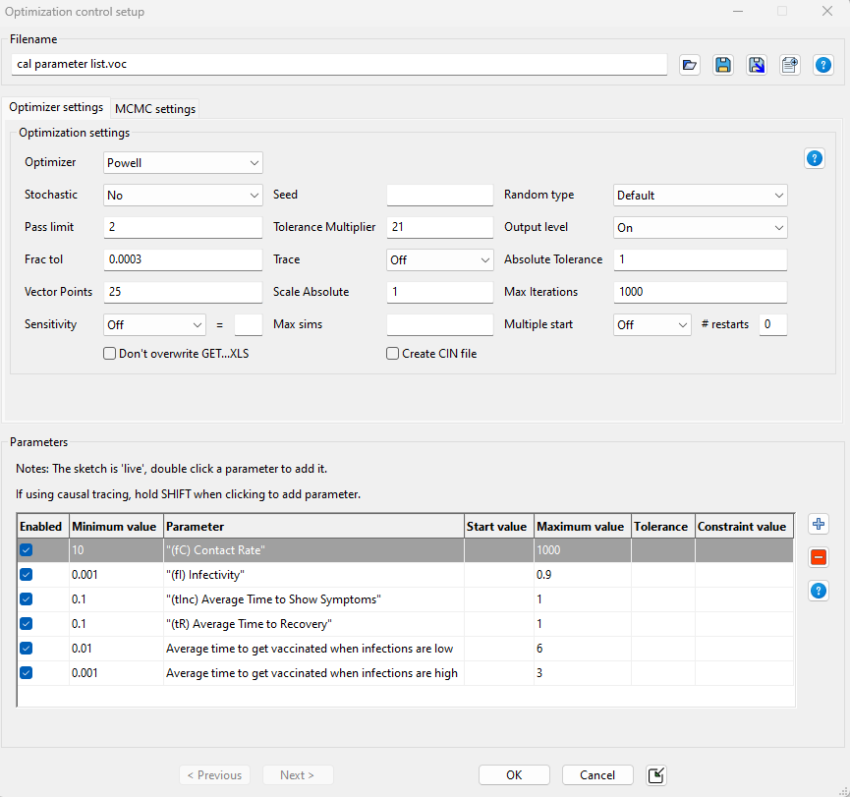
Calibration in Vensim ®
What do we need?
Optimization Control File (.voc file)
Specify which parameters to vary and ranges
Specify which optimization methods to use
In “Simulation Control” under “Optimize”
set up file `cal parameter list.voc` with the following settings:

Slide 31
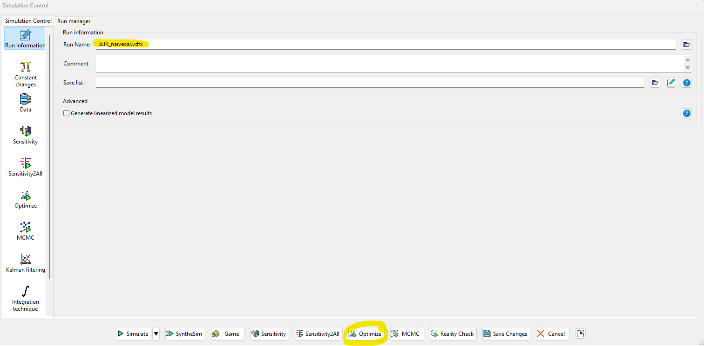
Calibration in Vensim ®
Let’s Calibrate!
Save the run name as “SEIR_naivecal.vdfx”
Hit “Optimize”

Slide 32
Calibration in Vensim ®
What do we get?
A Vensim® run with simulation results after setting the parameters to the best values obtained from the calibration (.vdfx file)
An output file summarizing the best parameter values from the calibration (.out file)
This file type can be loaded to set the values within the model to these new calibrated values, or be used as a starting point for another calibration or sensitivity analysis
A payoff report with diagnostic statistics on the calibration (.rep file)

Slide 33
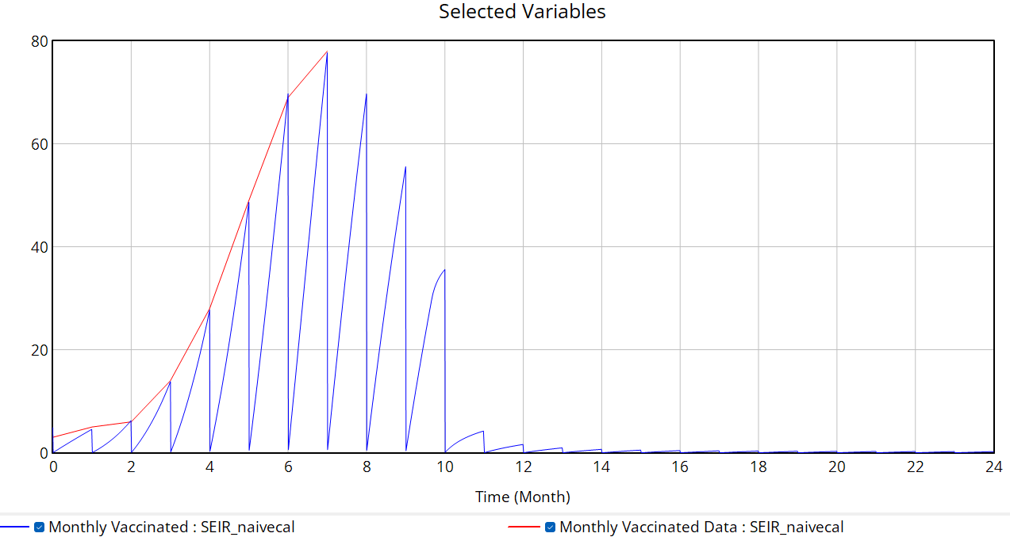
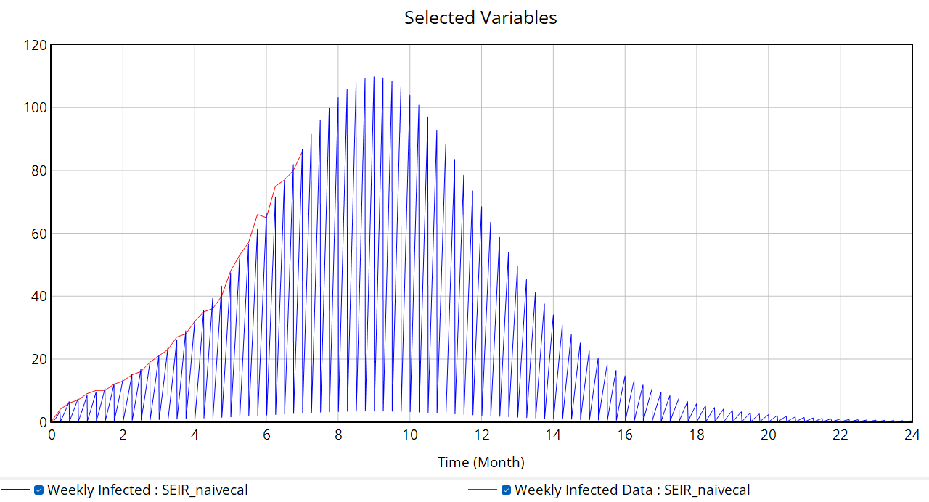
Calibration in Vensim ®
What do we get?
A Vensim® run with simulation results after setting the parameters to the best values obtained from the calibration (.vdfx file)
SEIR_naivecal.vdfx

Slide 34
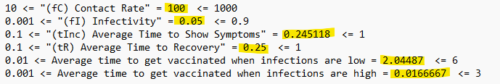
Calibration in Vensim ®
What do we get?
An output file summarizing the best parameter values from the calibration (.out file)
This file type can be loaded to set the values within the model to these new calibrated values, or be used as a starting point for another calibration or sensitivity analysis
SEIR_naivecal.out

Slide 35
Calibration in Vensim ®
What do we get?
A payoff report with diagnostic statistics on the calibration (.rep file)
SEIR_naivecal.rep
Um: difference in mean between model and data (systematic difference/bias)
Us: unequal variance (indicates difference in dynamics)
Uc: unequal covariance (most variance should be here)
For more details see Sterman (1984) “Appropriate summary statistics for evaluating the historical fit of system dynamics models” https://systemdynamics.org/wp-content/uploads/assets/dynamica/volume-10/10-2/4.pdf

Slide 36
Weighted Calibration using Maximum Likelihood Estimation

Slide 37
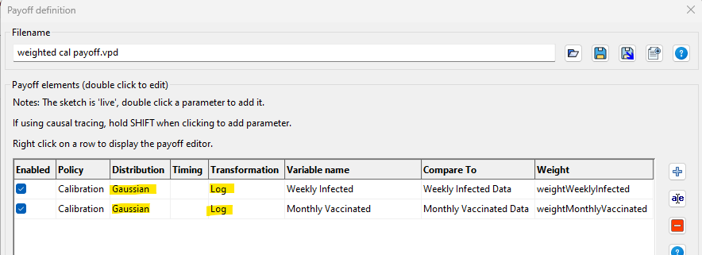
Update the payoff definition file
In “Simulation Control” under “Optimize”
set up file `weighted cal payoff.vpd` with the following settings:

Slide 38
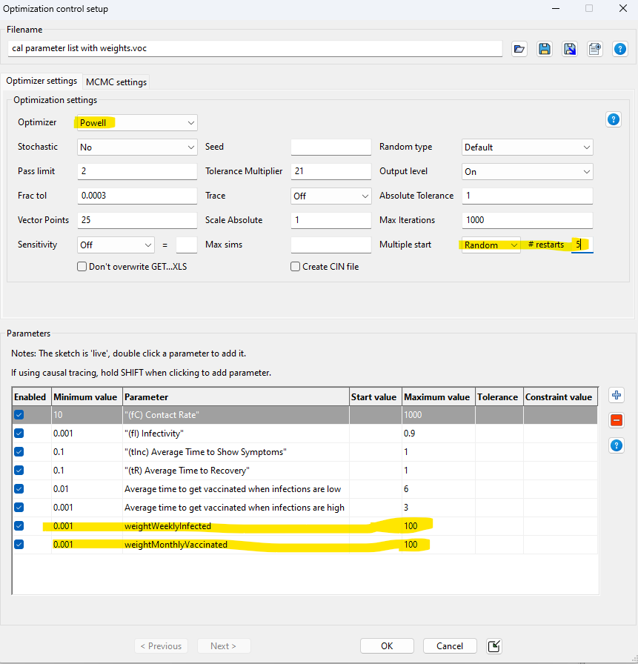
Update the optimization control file
In “Simulation Control” under “Optimize”
set up file `cal parameter list.voc` with the following settings:

Slide 39
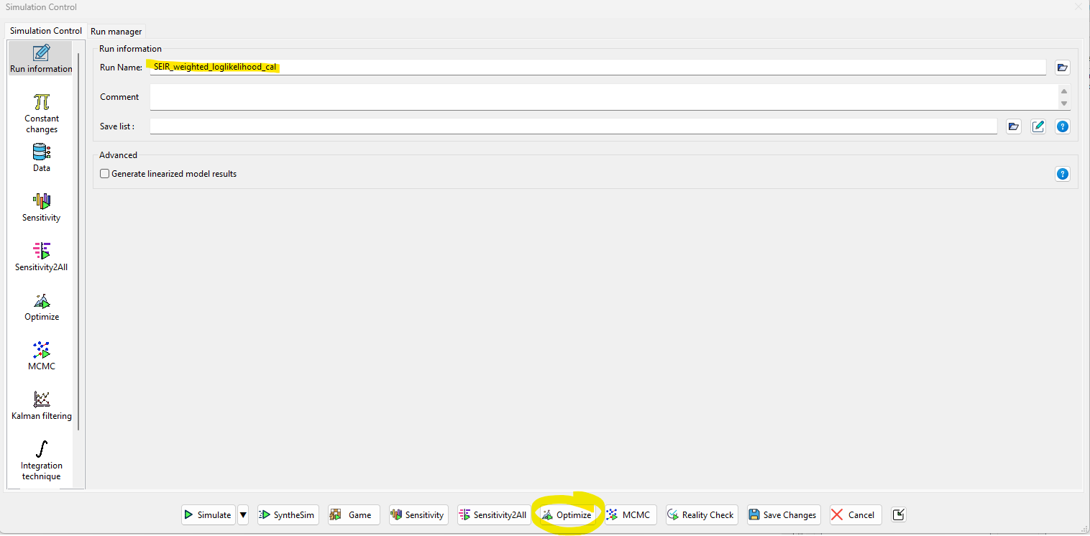
Calibration in Vensim ®
Let’s Calibrate!
Save the run name as “SEIR_weighted_loglikelihood_cal.vdfx”
Hit “Optimize”

Slide 40
Weighted log-likelihood calibration results
Explore the following files
SEIR_weighted_loglikelihood_cal.vdfx (Vensim® run)
SEIR_weighted_loglikelihood_cal.out (best parameter values found)
SEIR_weighted_loglikelihood_cal.rep (payoff diagnostics report)

Slide 41
Optional: calibrate a model with a structure mismatch
Using the same process as we took earlier, calibrate either of the following models towards the relevant data series
SIR model.mdl (simple SIR model, calibrate only towards weekly infections data)
SIR model with vaccinations.mdl (SIR model with vaccination structure, calibrate towards both weekly infections and monthly vaccinations data)
Were you able to obtain a good model fit with either calibration? Why or why not?
Is there any other information which you could think might help improve the model fit?

Slide 42
Break

Slide 43
Quantifying Uncertainty Using Markov Chain Monte Carlo Simulation

Slide 44
Quantifying Uncertainty: Generating Confidence Bounds
Why do we care about quantifying uncertainty of SD model parameters?
Evaluate predictive capacity of the model
Stakeholder decisions may rely on their degree of confidence in the model
Test to see if impacts of policies are (statistically) significantly different from zero
Does uncertainty matter for policy (do policy impacts differ under uncertain values of parameters?)
What additional data or information might narrow the confidence bounds (decrease uncertainty?)

Slide 45
Quantifying Uncertainty: Generating Confidence Bounds
Old Way
New Ways
Optimize to find the best fit of model to data
Explore the payoff space around the maximum payoff
Bootstrapping (draw random samples, with replacement, from the data)
See how estimates vary with different samples from data
Markov Chain Monte Carlo (MCMC)
Explore entire parameter space using random walk to see what parameter values are used most frequently
We will be focusing on applying MCMC to derive confidence bounds in this workshop

Slide 46
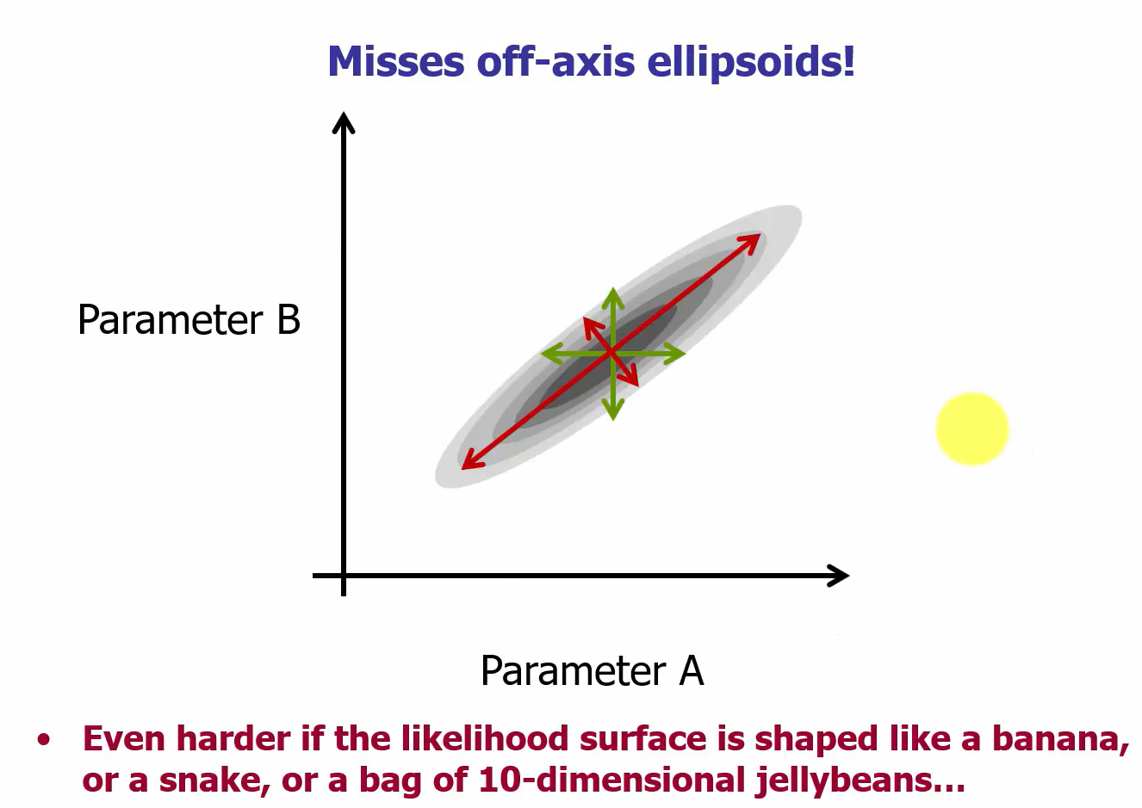
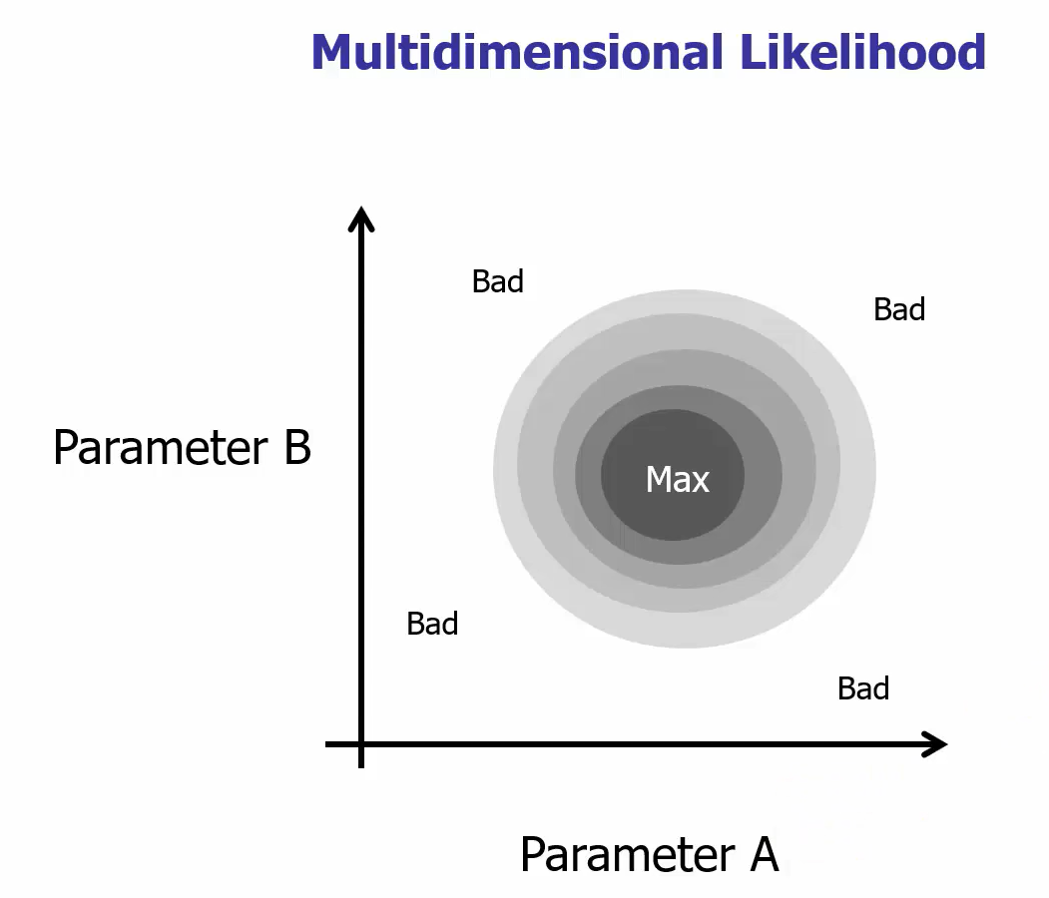
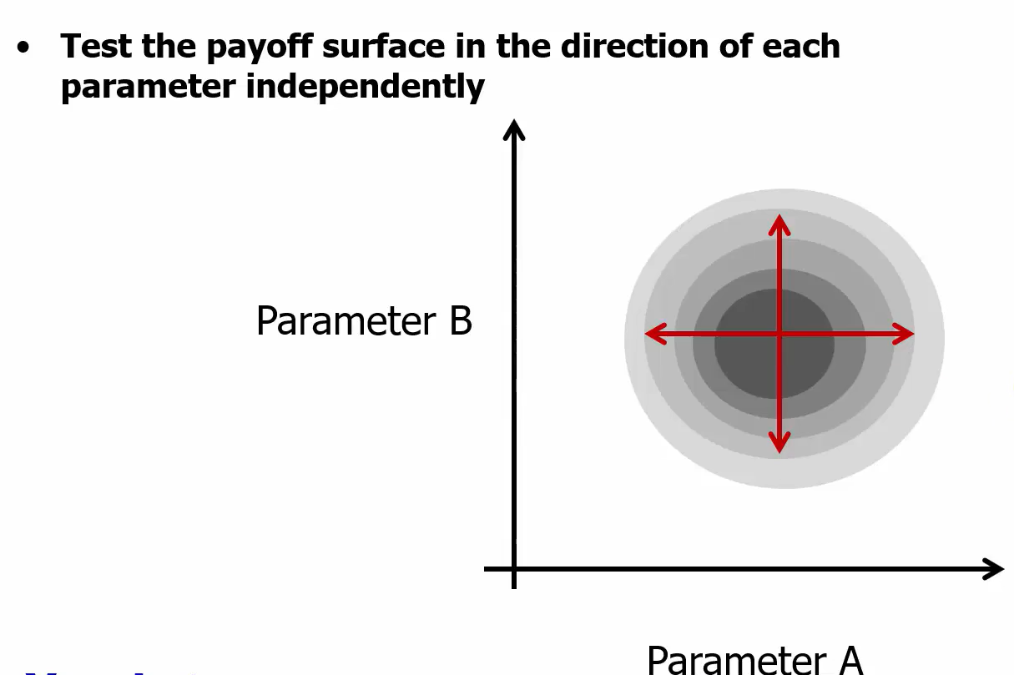
Quantifying Uncertainty: Generating Confidence Bounds
Old Way

Slide 47
MCMC Procedure
Perform a “random walk” over the payoff surface, with moves chosen according likelihood of payoff at proposed point
Stationary distribution of the Markov process reflects likelihood surface
After running for a long time, the random walk tends to concentrate in the areas of higher likelihood
Vensim® uses a differential evolution algorithm to guide walk (multiple Markov chains are run and recombined from population to propose next move)

Slide 48
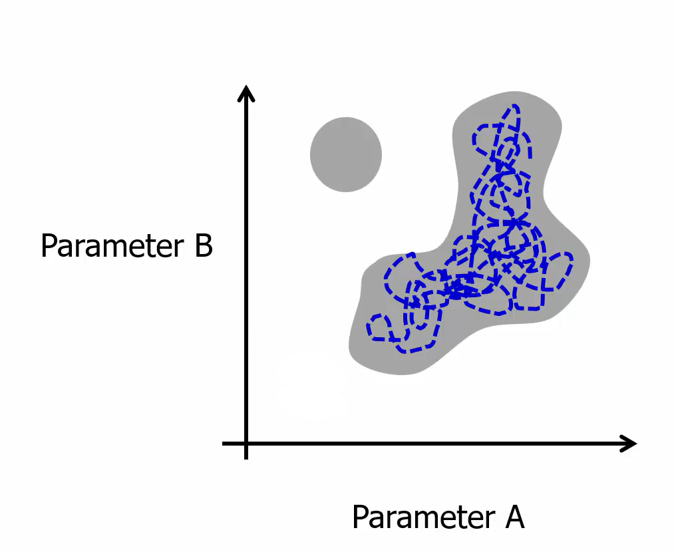
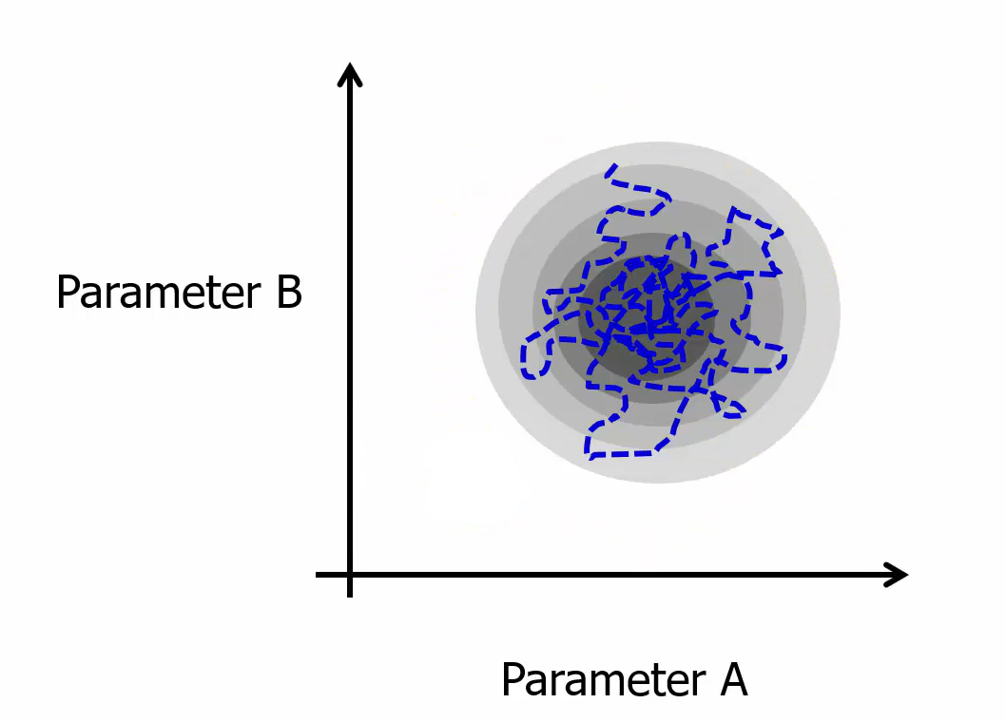
MCMC Procedure

Slide 49
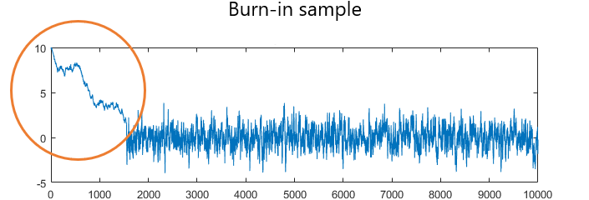
MCMC Procedure
Burn-In Period
Set of iterations of the random walk which are discarded
Eliminate draws whose distributions are far from the target distribution and highly variable
Sampling Period
Iterations of the random walk after the burn-in period ends
These are the runs we keep
Each run is a slightly different variation of the calibrated parameter values
Taboga, Marco (2021). "Markov Chain Monte Carlo (MCMC) methods", Lectures on probability theory and mathematical statistics. Kindle Direct Publishing. Online appendix. https://www.statlect.com/fundamentals-of-statistics/Markov-Chain-Monte-Carlo.

Slide 50
MCMC Convergence Statistics
PSRF: Measures the convergence of the random walk process
Does random walk fully occupy parameter space?
Should be below 1.2 for all parameters

Slide 51
MCMC in Vensim®
Payoff
Control File
We want the input to be (reasonably close to) a log-likelihood
We can use the same weighted payoff we already developed
Use the same parameter set
Change optimizer to MCMC
Possibly set other options

Slide 52
Load previous calibration
In “Simulation Control” under “Optimize”
set up file `weighted cal payoff.vpd` with the following settings (note that these are the
same settings we used for the weighted log-likelihood Powell calibration

Slide 53
Update the payoff definition file
In “Simulation Control” under “Optimize”
set up file `weighted cal payoff.vpd` with the following settings (note that these are the
same settings we used for the weighted log-likelihood Powell calibration

Slide 54
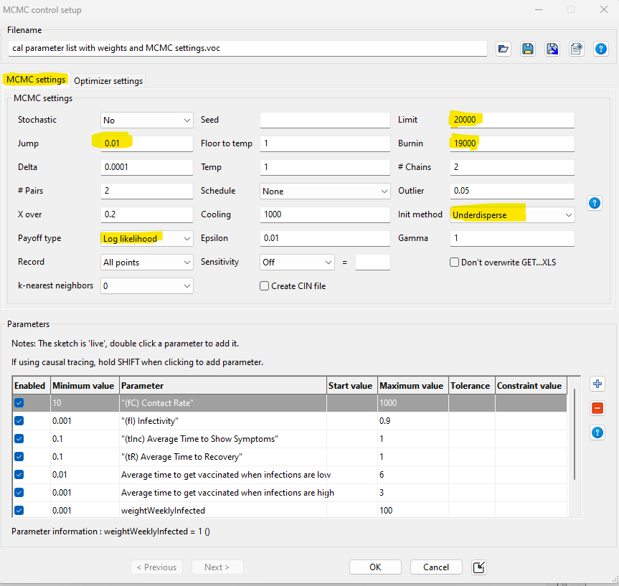
Update the optimization control file
In “Simulation Control” under “Optimize”
set up file `cal parameter list with weights
and MCMC settings.voc` with the
following settings (first switch “Optimizer
settings” to MCMC instead of Powell):

Slide 55
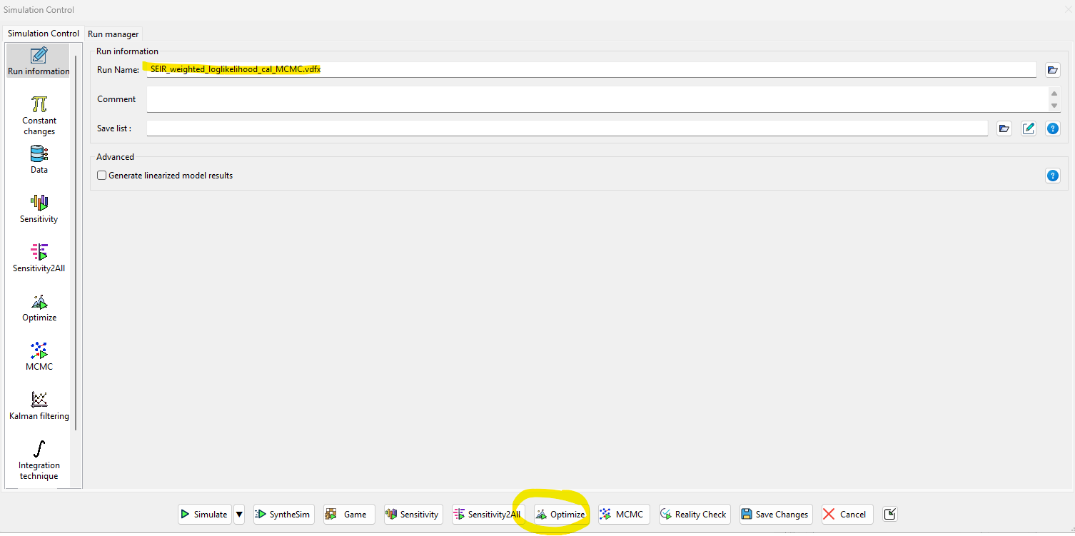
MCMC in Vensim ®
Let’s Calibrate!
Save the run name as “SEIR_weighted_loglikelihood_cal_MCMC.vdfx”
Hit “Optimize”

Slide 56
MCMC results
Explore the following files
SEIR_weighted_loglikelihood_cal_MCMC.vdfx (Vensim® run)
SEIR_weighted_loglikelihood_cal_MCMC.out (best parameter values found)
SEIR_weighted_loglikelihood_cal_MCMC_MCMC_stats.dat (best payoff and convergence diagnostics on random walk process)
SEIR_weighted_loglikelihood_cal_MCMC_MCMC_sample.tab (all points sampled after MCMC burn-in period)
SEIR_weighted_loglikelihood_cal_MCMC_MCMC_points.tab (all points explored during MCMC run)

Slide 57
Sensitivity Analysis Using MCMC Runs

Slide 58

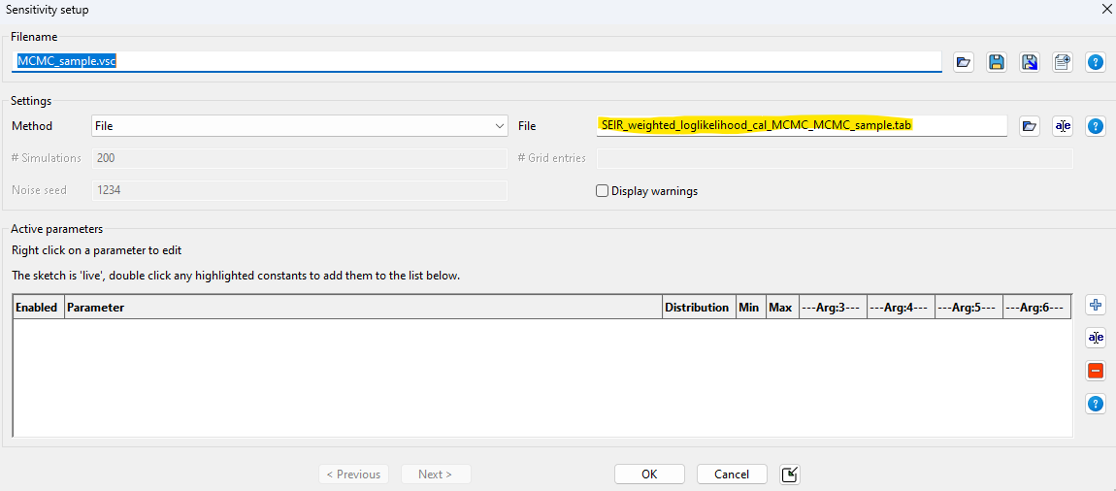
Set up sensitivity analysis using sample of 1000 MCMC runs
In “Simulation Control” under “Sensitivity”
set up file `MCMC_sample.vsc` by pointing to the file
`SEIR_weighted_loglikelihood_cal_MCMC_MCMC_sample.tab`

Slide 59
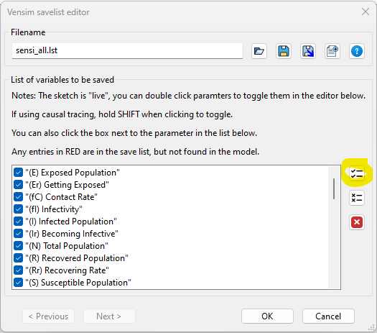
Select which parameters to include in sensitivity analysis
In “Simulation Control” under “Sensitivity”
set up file `sensi_all.lst` by selecting “All Variables”

Slide 60
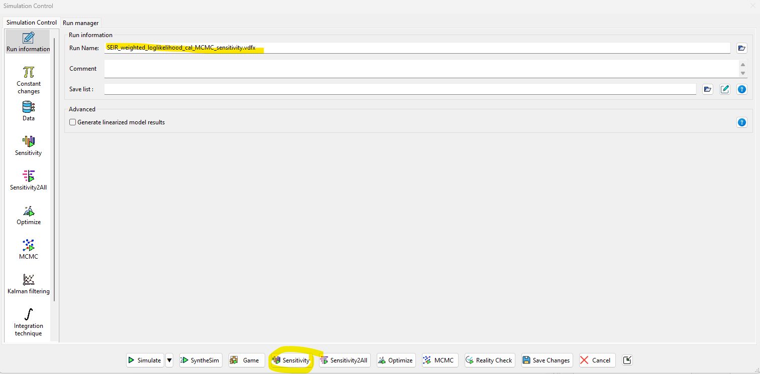
Sensitivity analysis
Let’s Simulate!
Save the run name as “SEIR_weighted_loglikelihood_cal_MCMC_sensitivity.vdfx”
Hit “Sensitivity”

Slide 61

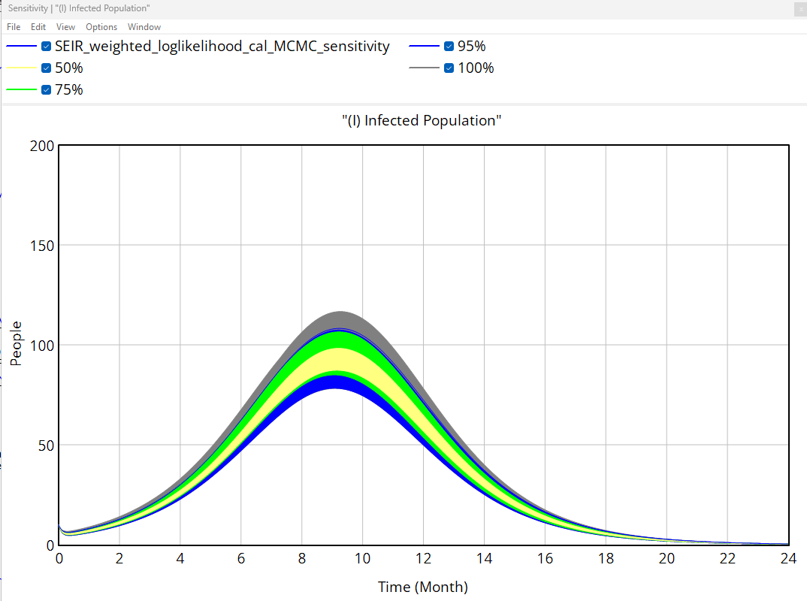
Sensitivity analysis
Let’s Simulate!
Confirm “SEIR_weighted_loglikelihood_cal_MCMC_sensitivity.vdfx” is loaded
Select any variable, and hit “Sensitivity Runs”

Slide 62
Wrap-Up

Slide 63
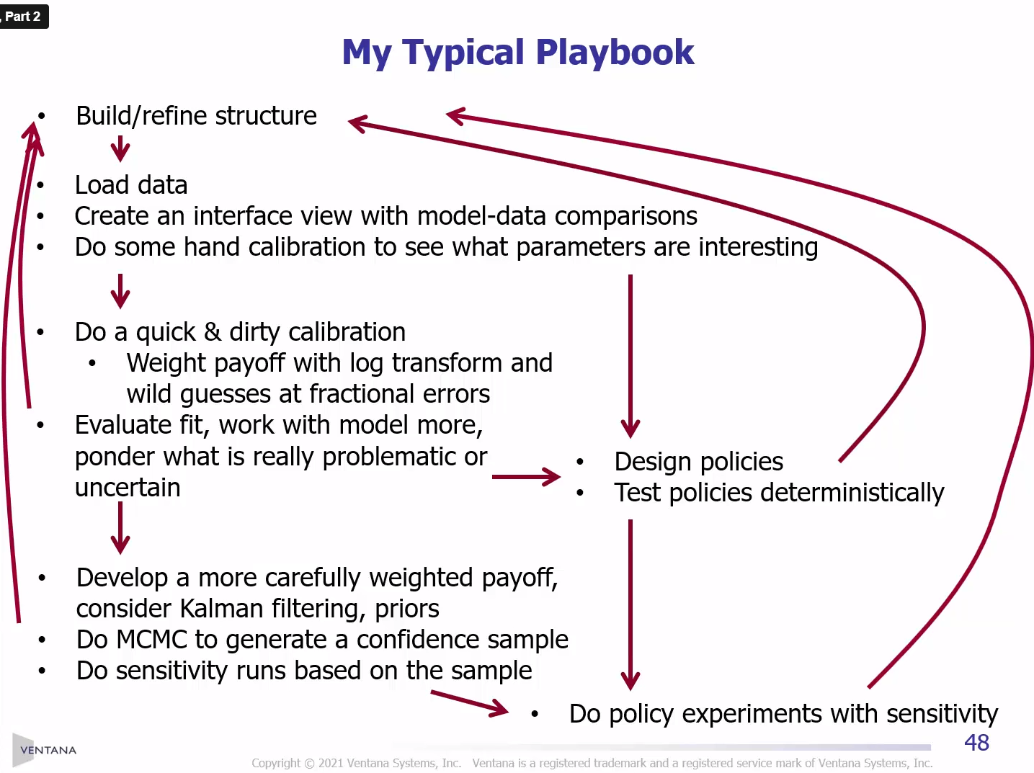
Tom Fiddaman’s

Slide 64
Additional Resources
https://vensim.com/vensim-video-library/
Andrade, J., & Duggan, J. (2021). A Bayesian approach to calibrate system dynamics models using Hamiltonian Monte Carlo. System Dynamics Review, 37(4), 283–309. https://doi.org/10.1002/sdr.1693
Barlas, Y. (1989). Multiple tests for validation of system dynamics type of simulation models. European Journal of Operational Research, 42(1), 59–87. https://doi.org/10.1016/0377-2217(89)90059-3
Barlas, Y. (1996). Formal aspects of model validity and validation in system dynamics. System Dynamics Review, 12(3), 183–210. https://doi.org/10.1002/(SICI)1099-1727(199623)12:3<183::AID-SDR103>3.0.CO;2-4
Dogan, G. (2007). Bootstrapping for confidence interval estimation and hypothesis testing for parameters of system dynamics models. System Dynamics Review, 23(4), 415–436. https://doi.org/10.1002/sdr.362
Oliva, R. (2003). Model calibration as a testing strategy for system dynamics models. European Journal of Operational Research, 151(3), 552–568. https://doi.org/10.1016/S0377-2217(02)00622-7
Rahmandad, H., Oliva, R., & Osgood, N. D. (2015). Analytical Methods for Dynamic Modelers. MIT Press.

